Slide 1
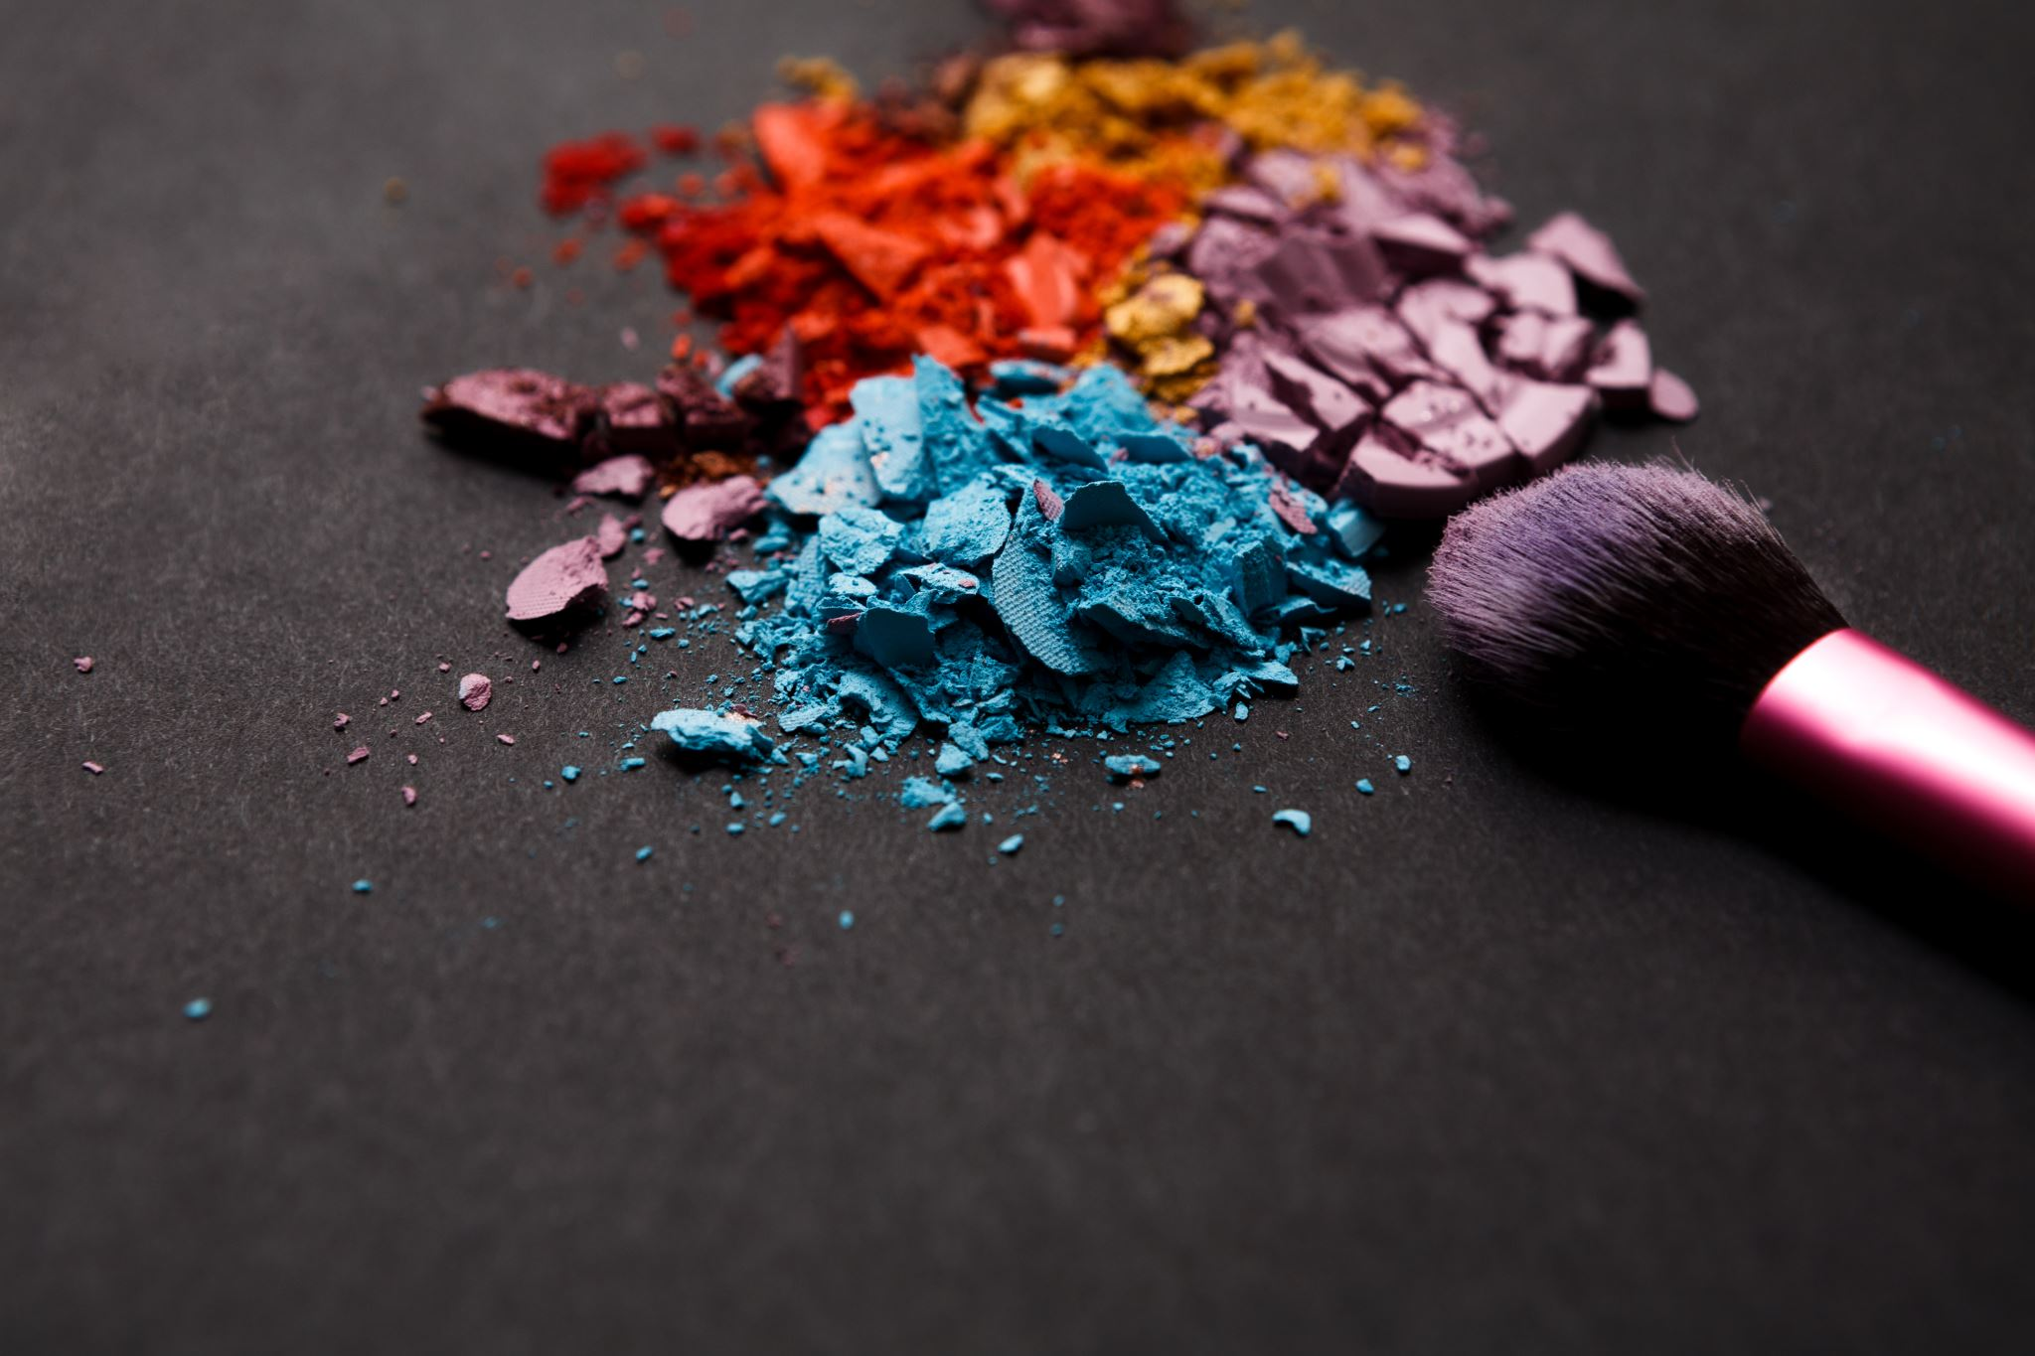
Chemicals in Cosmetics

Slide 2
Introduction
These data reflect information that has been reported to the California Safe Cosmetics Program (CSCP) in the California Department of Public Health (CDPH).
The primary purpose of the CSCP is to collect information on hazardous and potentially hazardous ingredients in cosmetic products sold in California and to make this information available to the public.
Companies with reportable ingredients in their products must submit information to the California Safe Cosmetics Program if the company:
Has annual aggregate sales of cosmetic products of one million dollars or more, and.
Has sold cosmetic products in California on or after January 1, 2007.

Slide 3
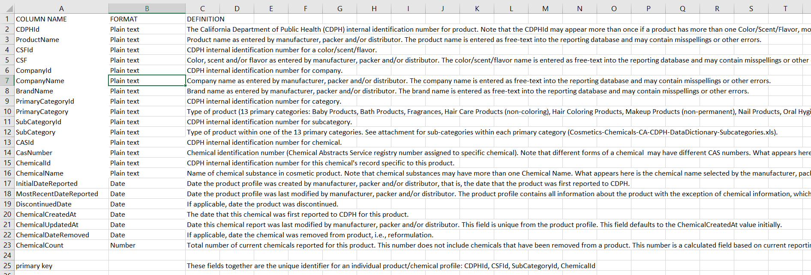
Data Description

Slide 4
Categories
Baby
Bath
Fragrances
Hair care
Hair coloring
Makeup
Nail
Personal care
Shaving
Skincare
Sun related

Slide 5

Chemicals in Cosmetics?
Nowadays customers are taking safety as priority and are curious to know everything about the product they are using, they want to know which chemicals are being used and which are the brand and the product category using those chemicals more.
We did some analysis and have found answers to those questions.
First let's start with which chemicals are used most?

Slide 6
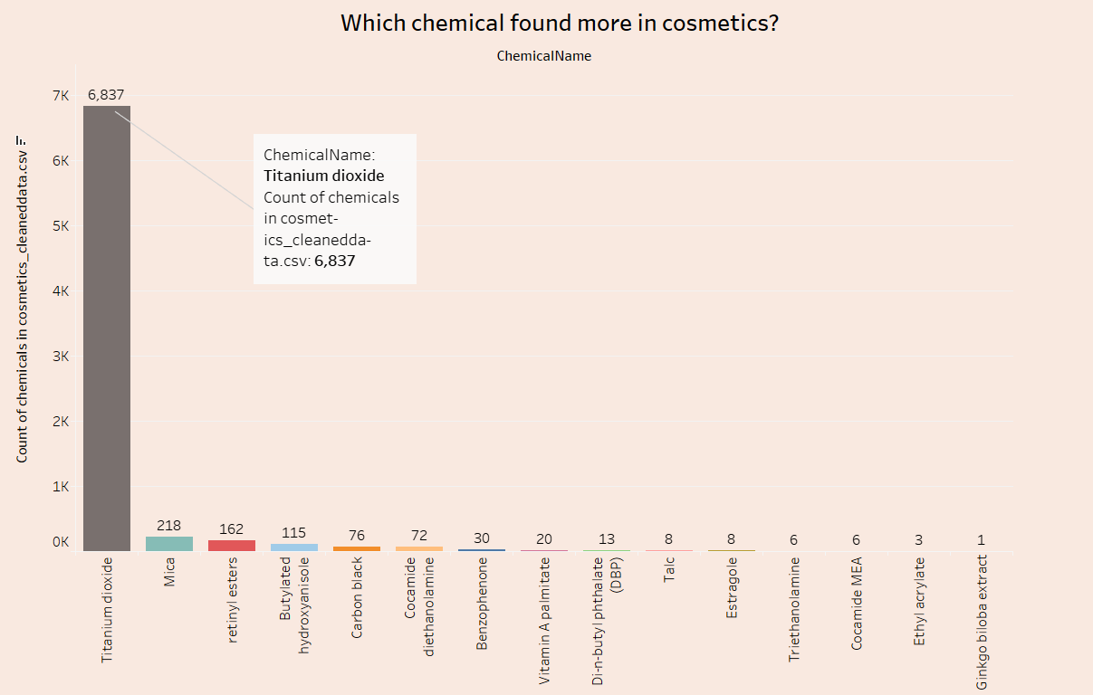

Slide 7

Make up or break up?

Slide 8
Should you be worried?
Many day-to-day product uses chemicals which are dangerous in high concentrations, and high doses.
Some people also may suffer allergic reaction to small quantity and can further leads to cancer if regularly used.

Slide 9
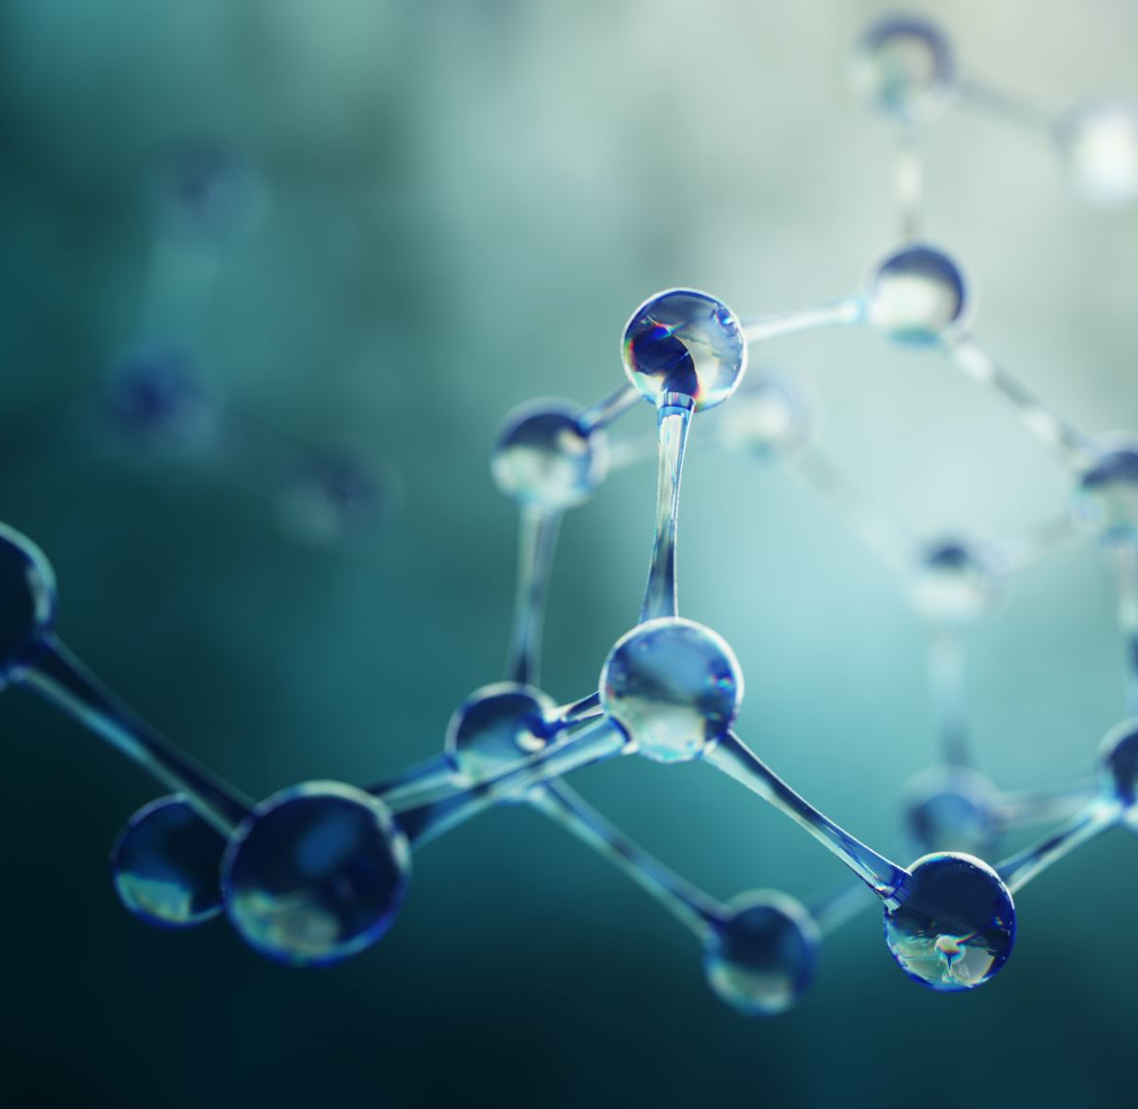
Which primary category contains more chemical?

Slide 10
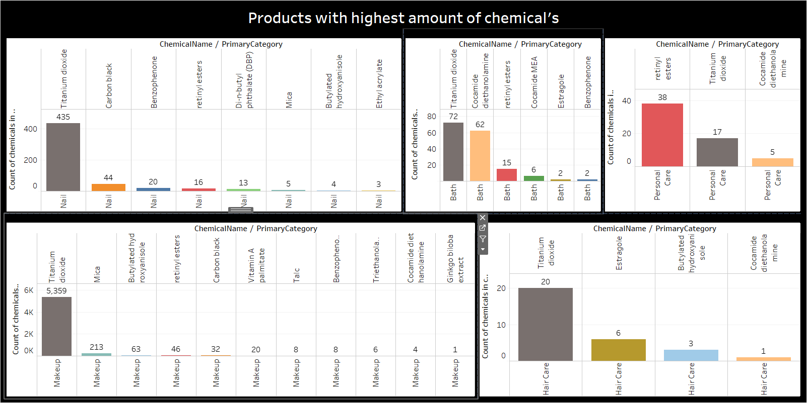

Slide 11
Brands using more chemicals in their products.

Slide 12
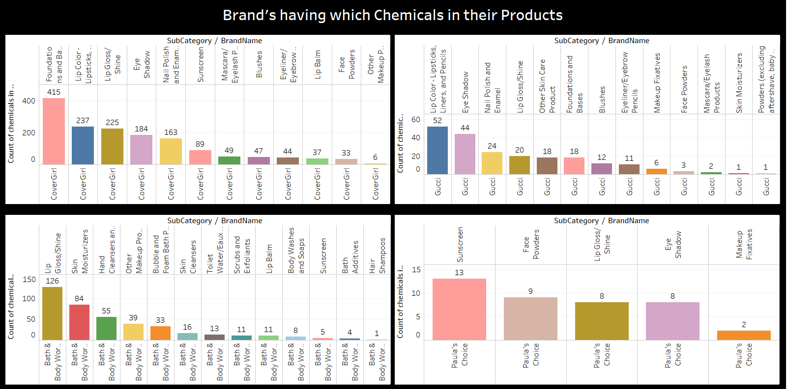

Slide 13
Analysis
We have added the additional columns to our dataset to get more insights of the data.
“Carcinogenesis” column was created using whether the chemical may result in formation of cancer cells (0 - no and 1-yes).
Another column is skin danger (0-5) scale, means how dangerous the chemical could be for skin. ( 0 is safe and 5 is most dangerous).
Enough research were done to make these columns.

Slide 14
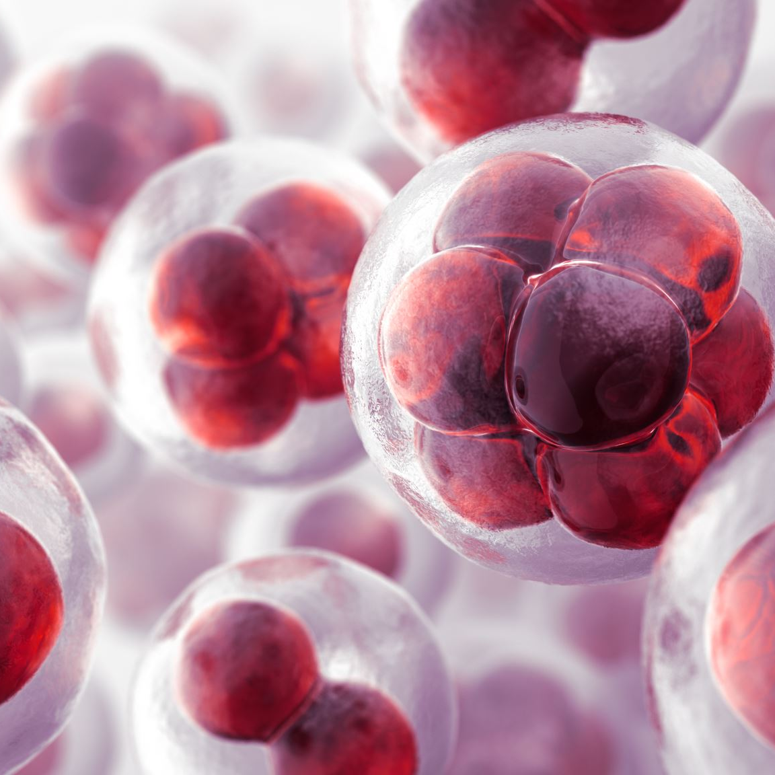
Carcinogens
A carcinogen is any substance, radionuclide, or radiation that promotes carcinogenesis, the formation of cancer.
The data shows the brands which have products without carcinogens in it.

Slide 15
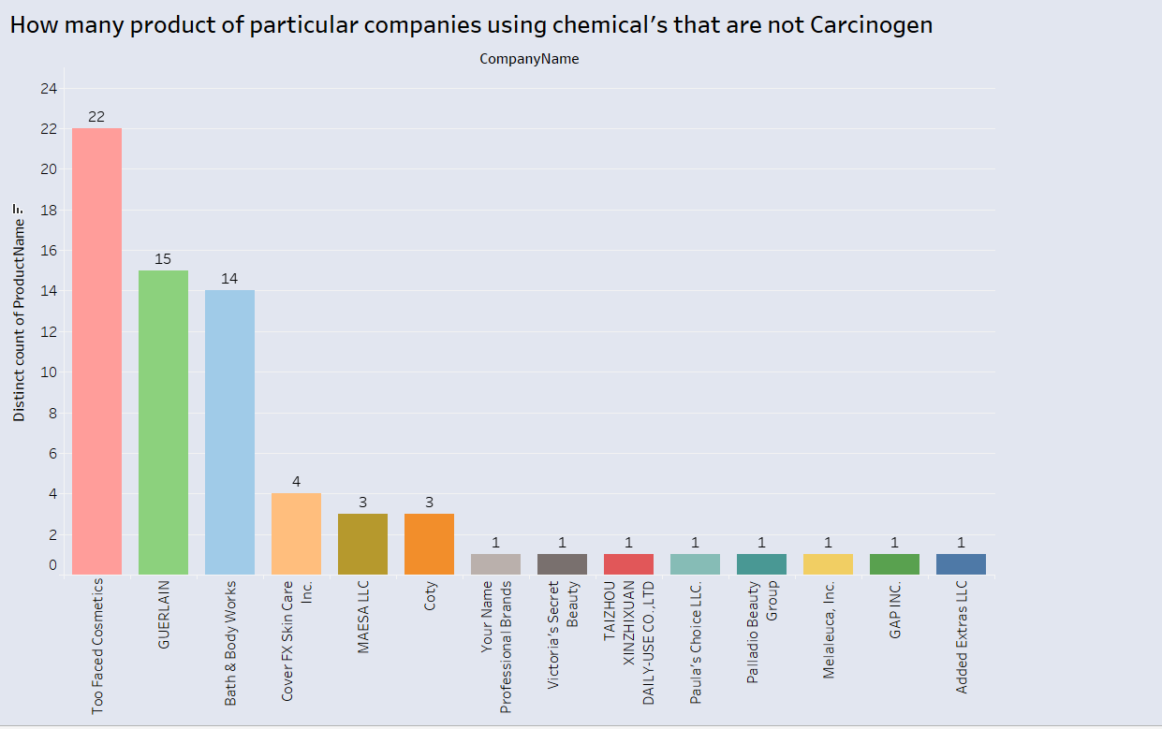

Slide 16
Skin Care
The data shows which chemicals are more dangerous to skin on the scale of 0 to 5.
Being 0 low and 5 high.
The Lollipop chart shows Estragole is most dangerous chemical for skin.

Slide 17
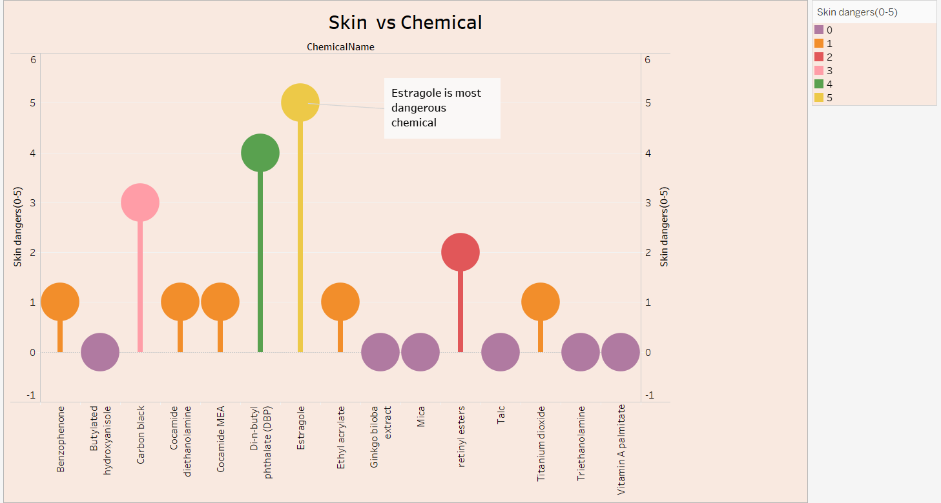

Slide 18
Brand’s products To avoid

Slide 19
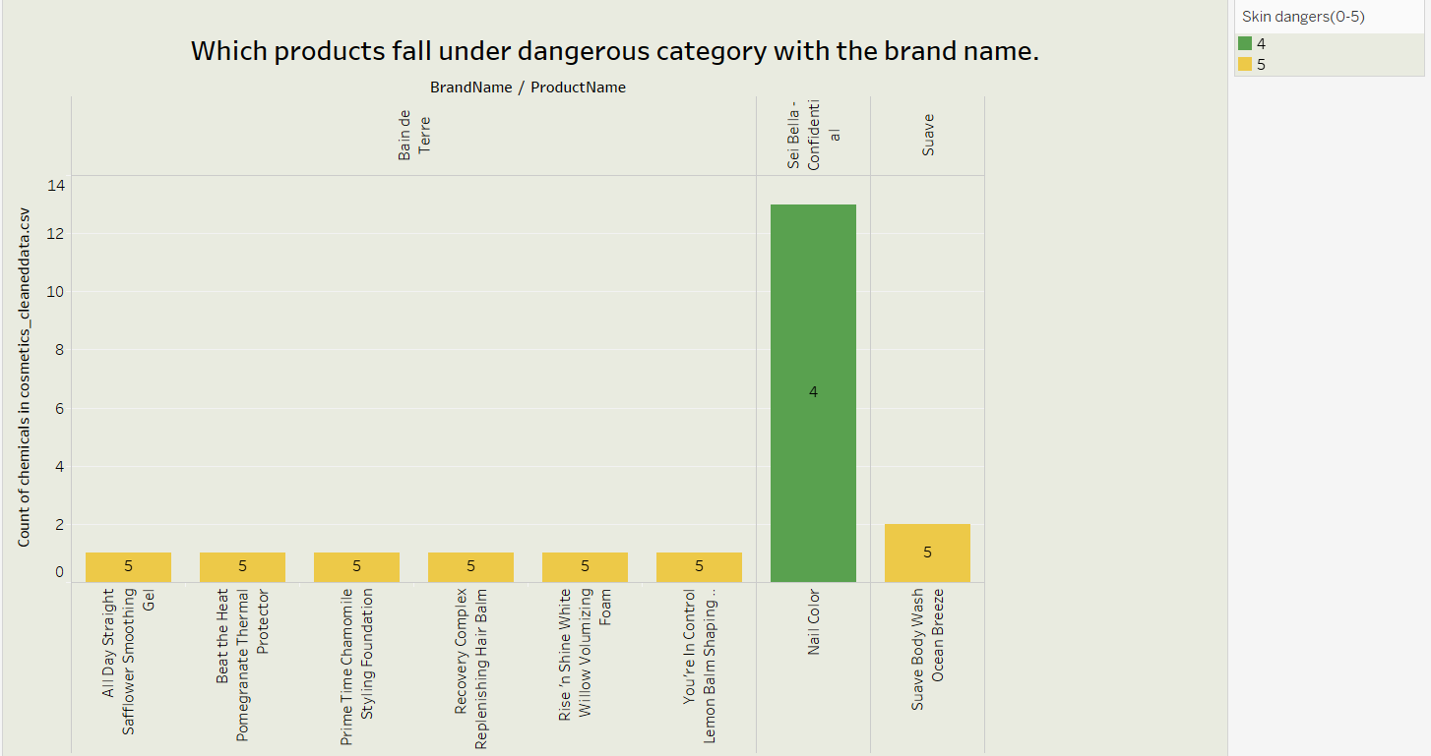

Slide 20
Brand, Category and Chemical
The following map shows which brand’s product category has how many chemicals in it.
As seen, Makeup tops the list with 1277 chemical in it of top brand Cover girl

Slide 21
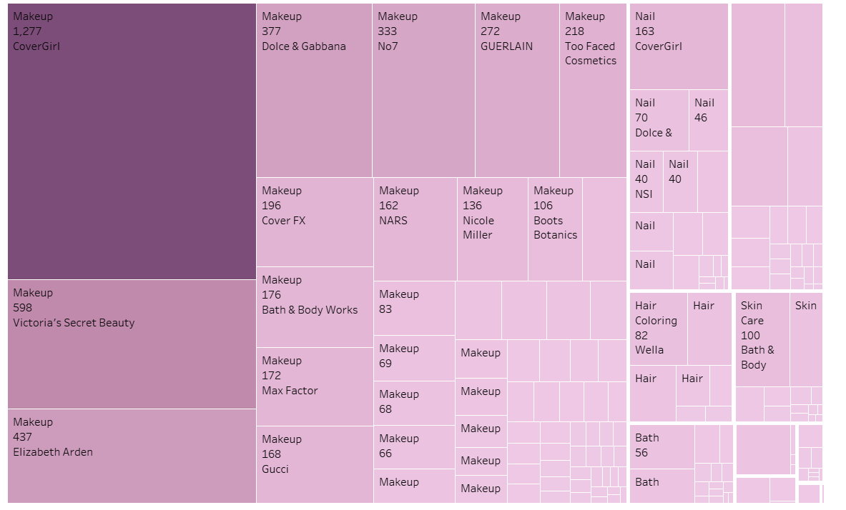

Slide 22

References
https://healthdata.gov/dataset/chemicals-cosmetics
List of reportable ingredients: www.cdph.ca.gov/ReportableIngredientsList
https://prhe.ucsf.edu/sites/g/files/tkssra341/f/CA%20Safe%20Cosmetics%20Program%20Report.pdf
http://www.safecosmetics.org/get-the-facts/chemicals-of-concern/known-carcinogens/
https://www.businessinsider.com/dangerous-chemicals-in-beauty-products-makeup-list-2019-6?amp

Slide 23

Any Questions?

Slide 24
Thank you
Group 9:
Anant Patel
Darshan Patel
Parth Sutariya
Rushil Patel
Ruchita Tamboli

